Slide 1


TASK MAPPING IN MANY-CORE SYSTEMS
Under guidance of
Dr. Jerry Trahan
BY
SANTHOSH RAMAIAH
Notes:
Good morning
Task mapping under jerry trahan
There are several challenges for many core system consisting communication paradigm, application characterization, communication infrastructure, analysis and solution evaluation.
In this work we address the problem mapping of application in large no of cores so that we reduce the communication energy consumption.

Slide 2
Outline
Introduction
System Model
Mapping Algorithms
Experimental Results
Conclusion and Future Works
References
Notes:
Introduction give brief overview on many core system and mapping problem
System model consists of NoC, Appl, energy model.
Mapping Algorithms- consists basics of scheduling. Particularly on mapping and various heuristics considered.
Experimental results consists results obtained by applying these mapping algorithms to randomly generated applications, real application task graphs. Also we use scheduler with mapping.
Conclusion and future works summarizes the all these and gives direction for further work to be done.
References – only few references are shown from which our work is derived from.

Slide 3
Introduction
Almost since the computer era began, the computer industry has been producing high performance parallel computing.
Processor manufacturers produced generations of processors with a doubling of clock rate as the number of transistors doubled.
High-level programming languages and compilers converted these hardware advancements to performance.
However, the increase in clock speed caused higher power consumption and heat dissipation.
Notes:
Say about high performance parallel computing.
After 1st point
In early days mostly bit-level parallelism and instruction level parallelism. (like 16 , 32, 64 )
Intel cofounder Gordon moore in 1965 predicted that number of transistors in a dense integrated circuit doubles approximately every two years (18 months).
This law held good as processor manufactures generation of processors.
High level programming and sophisticated compilers took advantages of this advancements.
But this led to higher power consumption and heat dissipation.

Slide 4
Introduction
This led to development of multi-core chip designs able to run at lower frequency, thus reducing heat and energy consumption.
Many-core systems consisting of hundreds of cores on a single chip are on the horizon.
A network-on-chip (NoC) is an intra-chip communication infrastructure, proposed as replacement to bus based designs.
For a many-core system consisting of hundreds of cores, the problem of efficiently scheduling applications is a significant challenge.
Notes:
This led to development
Many core systems consisting of hundreds of cores on a single chip are on horizon.
After 2nd point
This advantage of massively parallel computational resource can be used for solving highly complex and computationally demanding applications such as real-time audio/video encoding, image processing, facial recognition engines, on-demand data encryption, real time data processing.
After 3rd point
NoCs have replaced bus-based interconnects that are predominantly found in single and multi-core chips because NoC can avoid congestion when multiple cores communicate with each other.
After 4th point
Scheduling consists of region selection and mapping.
The region selection phase selects a region large enough to hold all tasks in an application.
The mapping phase places these tasks in cores in selected region. The problem of mapping tasks to cores so as to minimize communication energy.

Slide 5
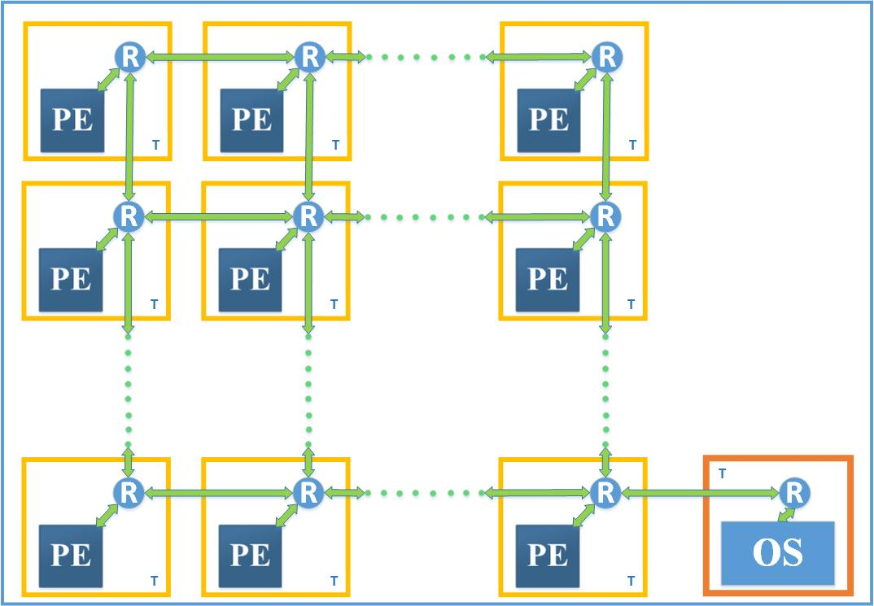
System Model: Network on Chip Architecture
Homogenous 2D NoC mesh
(OS-Operating System, PE-Processing Element (cores), R-Router, T-Tiles)
Notes:
After 1st point
Our work focuses on a many-core system with a 2D mesh as interconnection among tiles.
Each tile consists of a homogeneous core (or processing element) and a router.
After 2nd point
Only one task at a time can be run on a core.
A minimal transmission control protocol (TCP) routing stack is assumed for communication between routers for transmitting both control and data messages. This TCP protocol ensures the communication is reliable and error checked.
After last
The cores operate at the same voltage and frequency.
A specialized processor is included in the NoC architecture, and it is optimized to run the operating system.
The operating system includes an application scheduler with a mapping manager (MM) as a part of the scheduler.

Slide 6
Functioning of mapping manager
Online scheduling handles applications as they arrive.
The process of scheduling consists of region selection and mapping.
The region selection algorithm searches the free space area to find a rectangle that is large enough to hold an application [2].
The mapping manager assigns the tasks of the incoming application to cores in the selected region.
The mapping manager runs a dynamic mapping algorithm to map the incoming tasks of an application to various cores.

Slide 7
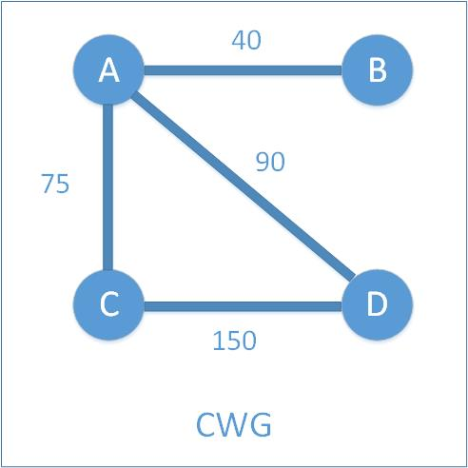
Application Characteristics
An incoming application is
represented by a communication
weighted graph (CWG).
The nodes represent the different
tasks and edges represent the
inter-task communication.
The volume of communication between a pair of tasks is represented by the weight of the corresponding edge.
Edges are undirected.
The weight on an edge captures communication volume in both directions.
Notes:
Application consists set of tasks.

Slide 8
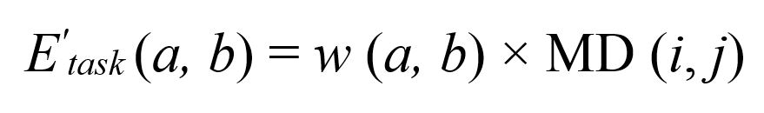
NoC Energy Model
Energy consumption occurs in all elements including interconnection network, routers, and cores.
The dynamic energy is constituted mainly by inter-process communication.
For tasks a and b mapped to cores i and j, respectively, the communication cost between them is the product of weight w(a, b) of that edge and the Manhattan distance between core i and core j.
Notes:
After 1st point
This work focuses only on dynamic energy, as mapping algorithms do not affect static energy.
After 2nd point
After 3rd point
For a given application with n tasks, the communication energy is the summation of energy consumed by all pairs of communicating tasks
Last point
Finally, the total amount of communication energy consumption occurring in a many-core is the summation of dynamic energy consumed all applications.

Slide 9
Mapping Algorithms
The mapping algorithms in this work focus on an online setting.
We take a heuristic-based approach to get solutions for the mapping problem.
The scheduler passes the CWG of an application and dimensions of the selected region to the mapper.
The mapper with this information performs mapping of all the tasks to cores in the selected region.
Notes:
After 1st point
Here, the available time to map the tasks of an application is limited, hence the algorithms cannot evaluate all the mapping possibilities.
After 2nd point
In this work, an arriving application includes information regarding total number of tasks and their communication weight
The scheduler (in general terms for region selection) looks into this information and selects a region large enough to hold all tasks in an applications.
After 3rd point

Slide 10
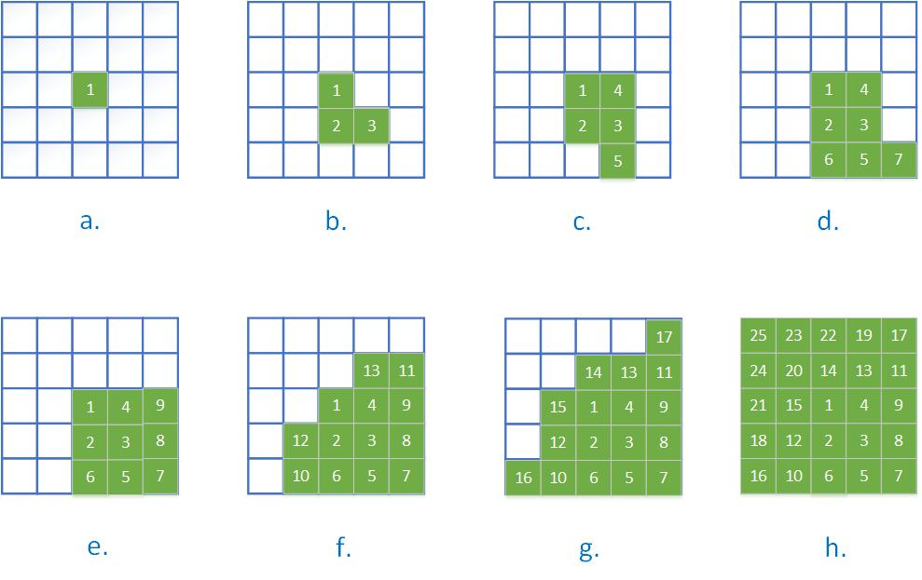
Euclidean Algorithm
In the Euclidean Minimum (EM) mapping technique, a task is placed at the free core with minimum Euclidean Distance to the center of the allocated cores [1].
Notes:
Tell 1st point
Figure shows the sequence of task mapping for a randomly generated task graph
Initially, the center of the allotted mesh is chosen for mapping the first task.
As for placing the next task onto the mesh of cores, we update the center (p_{c}, q_{c}) by recalculating the arithmetic mean of the locations of the mapped cores, then select a free core (p, q) with minimum Euclidean distance to the updated center.
This causes the center of the arithmetic mean of the mapped core to be pulled to the fourth quadrant, hence filling up the fourth quadrant and then growing upwards.

Slide 11
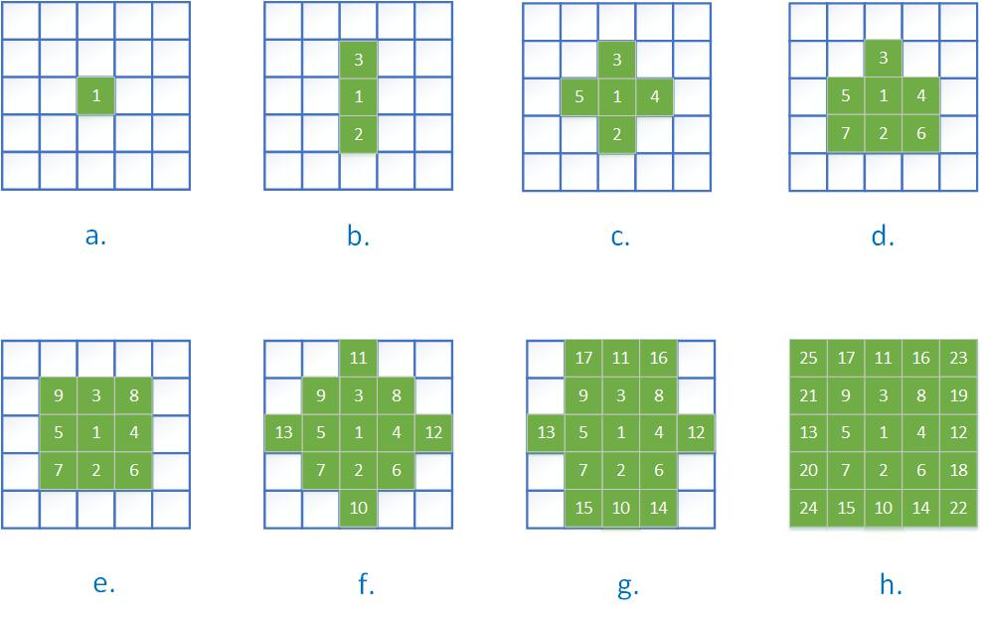
Fixed Center
The Fixed Center (FC) technique places each task after the first at the free core with minimum Manhattan Distance to the first allocated core [1].
Notes:
after 1st point
Initially, we set the location of the first mapped core as the fixed center (p_{c}, q_{c}) and then start mapping other tasks.
Unlike the Euclidean Minimum algorithm, the fixed center maps tasks around the center of mesh of cores.

Slide 12
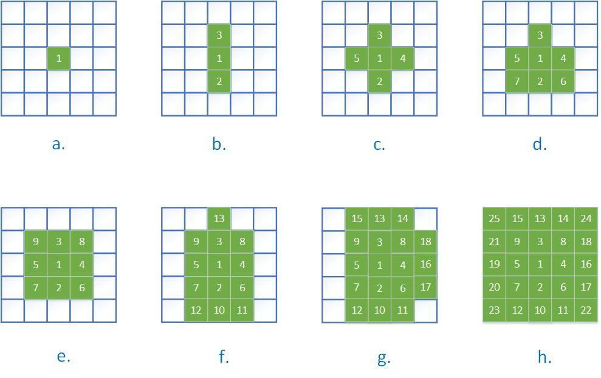
Neighbor-Aware Frontier
Neighbor-Aware Frontier (NF) places a task at the free core on the frontier of allocated cores with minimum number of free neighbors [1].
Notes:
After 1st point
The frontier list consists of free cores that are adjacent to mapped cores.
The implementation is similar to Euclidean Minimum, but instead of considering distance to average center, the NF algorithm uses the frontier list to count neighbors. Based on the count of neighbors, it places the task onto a free core.
Say about figure considers only nsew.

Slide 13
Largest Communication First
Largest Communication First (LCF) algorithm attempts to match the number of edges incident on a task to the number of links to a core [3].
So, it tries to map tasks with ≥ 4 edges to cores with 4 links, tasks with 3 edges to cores with 3 links, and tasks with ≤ 2 edges to cores with 2 links.
LCF also gives priority to tasks with the most communication for mapping over tasks with less communication.
Notes:
Read the slides

Slide 14
Algorithm for LCF [3]
// 1nd Step
createTheCoreTypeList (NoC Topology);
// 2rd Step
assignTasksToCoresTypes ();
// 3th Step
mapTasksToNoC (listOfTasksAssignedTo4PortCore);
mapTasksToNoC (listOfTasksAssignedTo3PortCore);
mapTasksToNoC (listOfTasksAssignedTo2PortCore);
mapTasksToNoC (remainingTasks);
Notes:
The LCF algorithm consists of three steps.
The first step is to create a set of cores of different types, based on number of links to neighbors in the NoC architecture.
The second step assigns each task to a core type, based on whether it has at most two, three, or at least four edges to other tasks in the application graph.
. If the number of edges for a task is ≤ 2, and the number of available cores with two links is greater than zero, then this task is assigned to list A2 for this core type C2 and number of cores with two links is decremented. However, if no cores with two links are available, then the task is pushed to waiting list W2.
The last step is the mapping of tasks to cores, considering the type of each core.
First, tasks in A4 are mapped to cores with 4 links and so on…

Slide 15
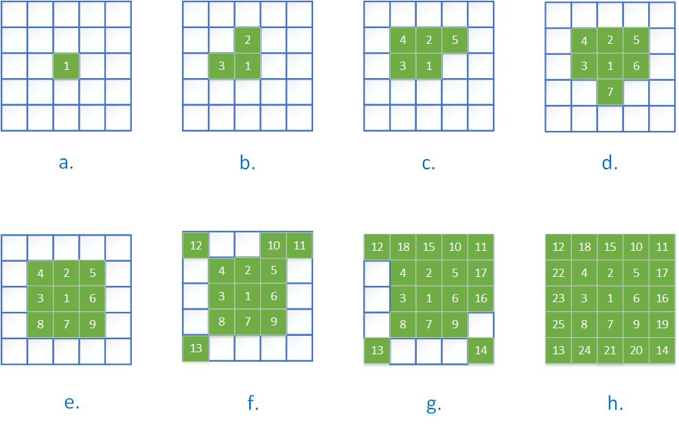
Illustration for LCF algorithm.
Notes:
Figure 3.4 shows the sequence of task placement resulting from LCF, which differs significantly from previous algorithms.
An LCF mapping depends on the specific CWG graph of an application.
In the preceding examples, 1 through 25 were the tasks in order of decreasing communication volume.
however, they are tasks in the order in which they were placed

Slide 16
Placed Communication First
The main focus of Placed Communication First (PCF) [4] is to place a task with a large amount of communication to already-placed tasks rather than waiting behind tasks with less communication to placed tasks.
Initially, place the task with largest overall communication volume.
Afterwards, among the unplaced tasks, choose and place the one with largest communication volume to the tasks that have already been placed.
While placing a task at this stage PCF evaluates all the frontier list of cores for communication energy cost and then selects the core with lowest cost to place the chosen task.
Notes:
Last point
whenever you place a task we need to update the list based on already placed tasks.

Slide 17
Contributions to PCF
First, PCF algorithm selected the core at which to place a task based on energy cost to the one placed task with which it communicates to most.
To increase energy savings, we consider placing a task at the free core with lowest cost with respect to all of the already placed tasks.
Second, several array structures were modified to run the algorithm faster in MATLAB implementation.
Third, we added a communication adjacency list representation of the CWG to the communication adjacency matrix

Slide 18
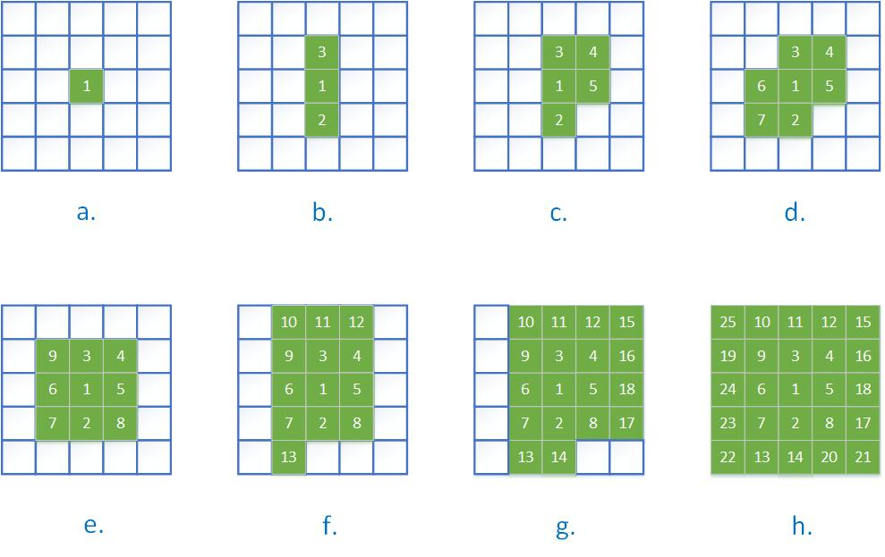
Illustration for PCF algorithm.
Notes:
Make sure mention
*the numbering of task from 1 to 25 shows the order which a task is placed on to mesh of cores, but this order is not by overall communication volume.
This is because the PCF algorithm places the task with large amount of communication with already placed tasks and does not consider communication with unplaced tasks.

Slide 19
Experimental Results
The various input parameters considered in this work are: tasks per application, number of applications, min/max edge weight, number of runs per setting, size of NoC mesh, edge ratios and edge percentage.
Communication Energy Cost is the total cost of communication occurring within a mapped application in a mesh of cores.
Execution time is the time taken to map all the tasks in an application by the mapping algorithm.
For our results we normalize the above two measures to corresponding PCF results.
Notes:
After last point
Normalized Cost - ratio of communication energy cost obtained by other algorithms to communication energy cost obtained by PCF.
The mapping algorithms are run in MATLAB environment with 64bit- Intel core I5-2400 3.10 GHz processor and 8 GB Memory.

Slide 20
Simulation results for mapping only
The applications in these experiments include both randomly generated task graphs and real application task graphs.
The number of edges generated randomly for an application is controlled by edge ratio or edge percentage.
We use two measures to characterize the number of edges in a graph because of distortions in some cases.
Real application task graphs generally have low edge ratio or edge percentage.
Notes:
After second point
The edge ratio is the ratio of total number of edges to total number of tasks in an application.
The edge percentage is the percentage of total number of edges possible for a given number of tasks.
We use two measures to characterize the number of edges in a graph because of distortions in some cases.
For example, when edge ratio is large (in range 20), and an application has a small number of tasks, the task graph is fully connected.
After last point
Real application task graphs edge ratio in range [1 – 1.343] average 1.09 edge percentage in range [8.6% - 28.6%] 17.88%

Slide 21
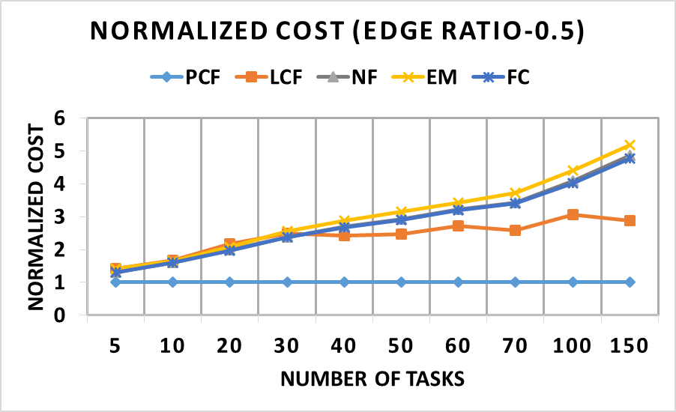
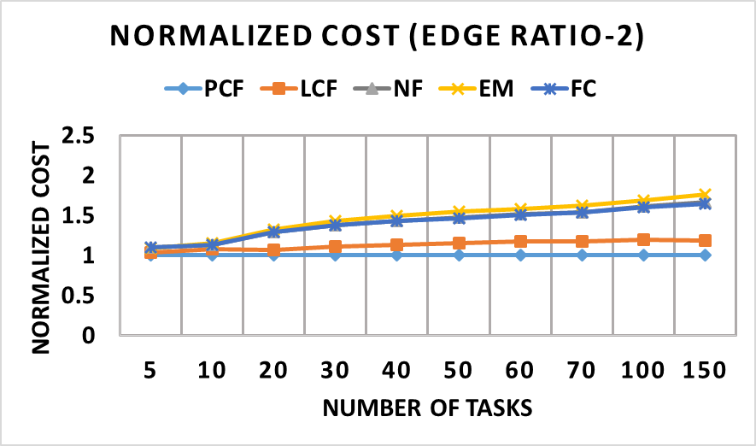
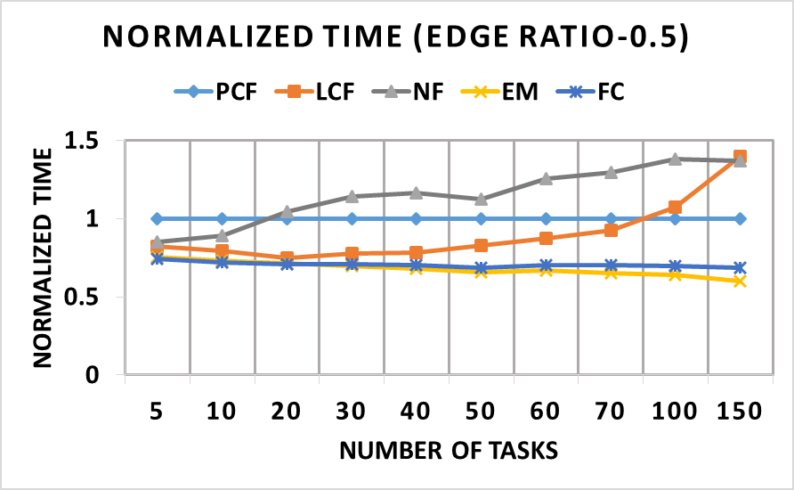
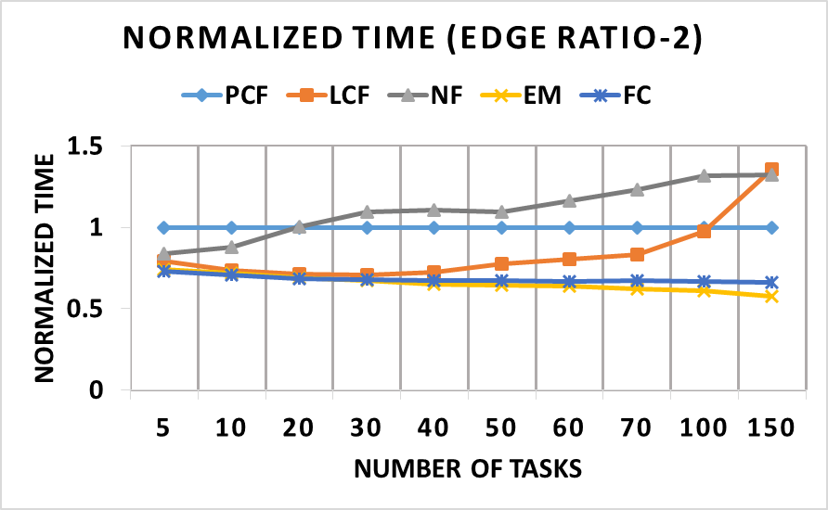
Mapping – Edge Ratio
Notes:
We randomly generated task graphs using ranges of various parameter values. And feed it to mapping manager without scheduler.
The edge ratios considered here are 0.5, 2.
The edge weight is always 1
number of runs per setting is 210. which means for a given set of parameters 210 different applications are generated and the reported results are the average of the results over these 210 runs.
Show the difference in scale in graphs
The results show that for normalized cost, the PCF algorithm gives greater energy savings at lower edge ratios in which the graph is less connected.
The cost saving increases as the number of tasks in an application increases.
From normalized time, the PCF algorithm takes longer time when compared with most other mapping algorithms.

Slide 22
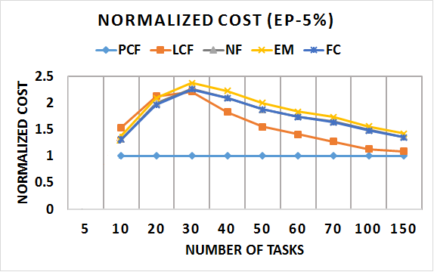
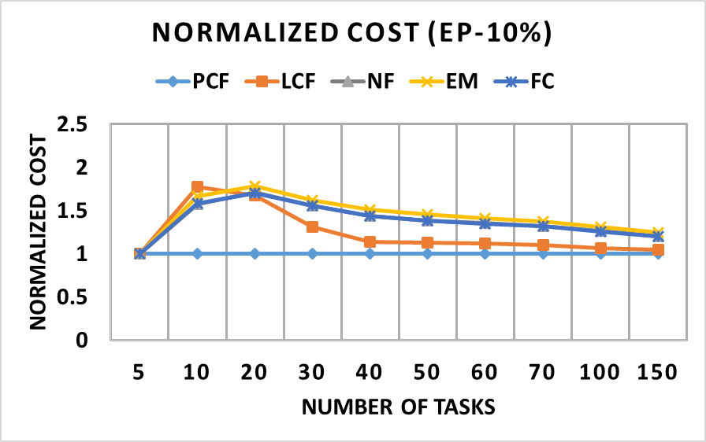
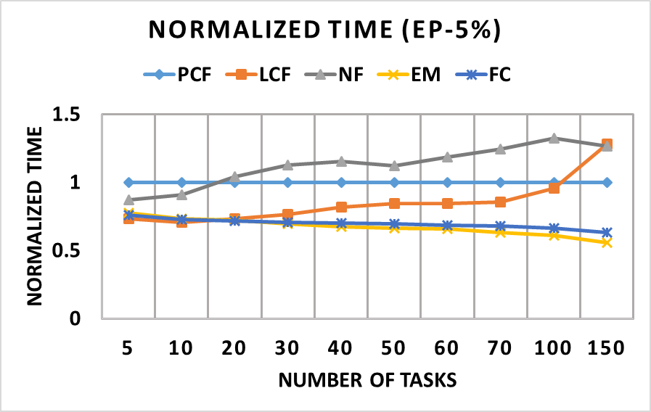
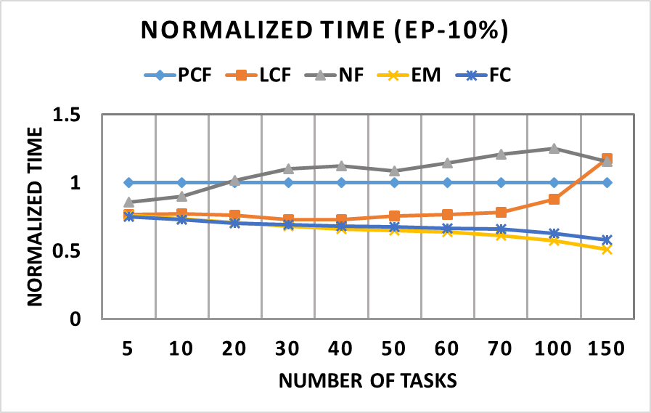
Mapping – Edge Percentage
Notes:
The edge percentages can be used to analyze small applications.
The edge percentage considered here are 5%, 10%.
maximum edge weight of 1.
Number of runs per setting is same
The PCF algorithm gives greater energy saving for lower edge percentages and the energy saving decreases as the edge percentage and application size increases.

Slide 23
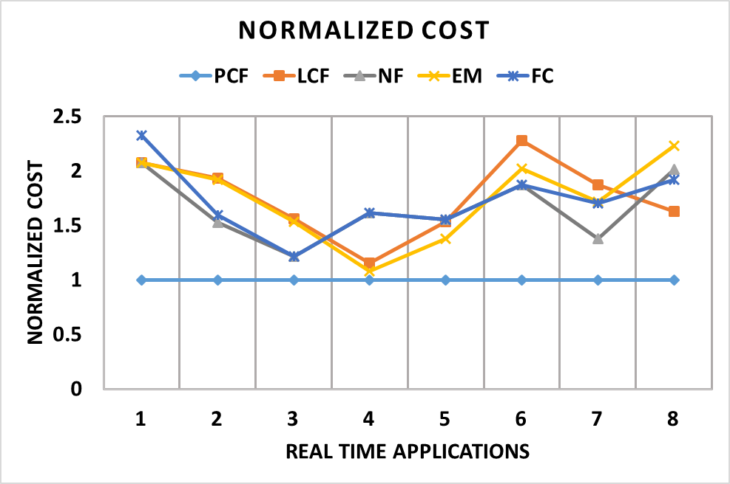
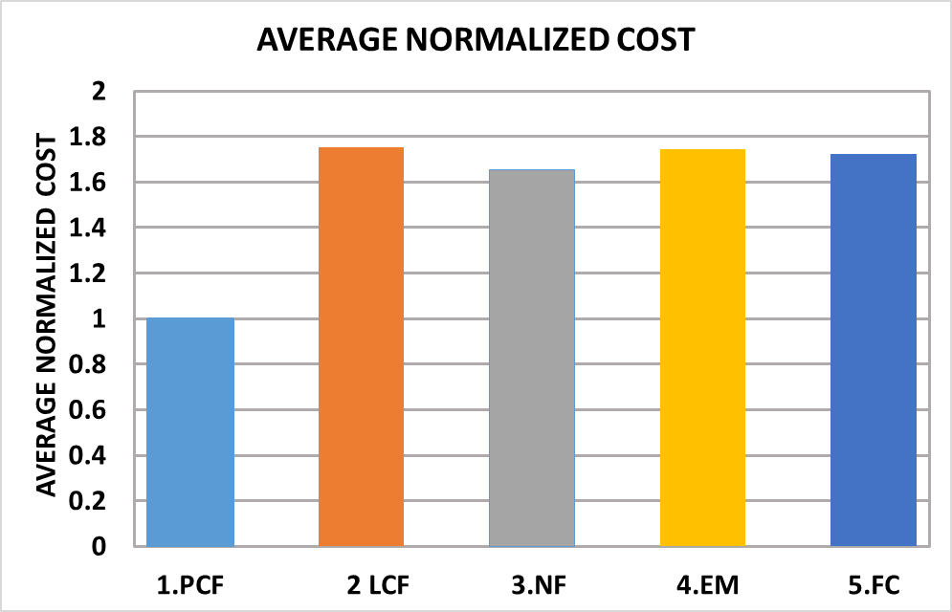
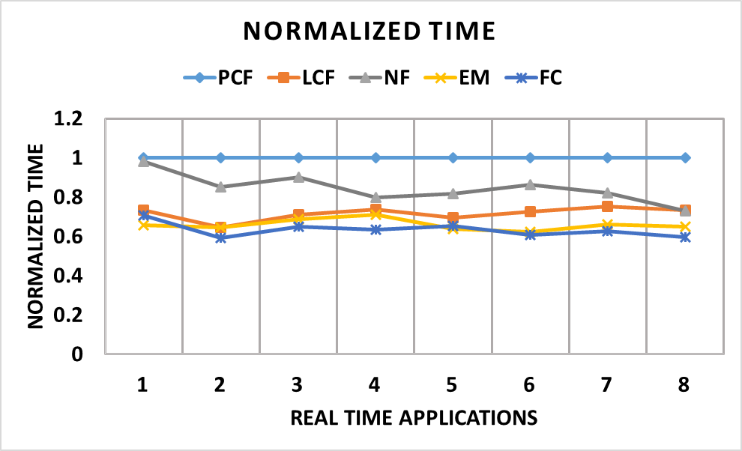
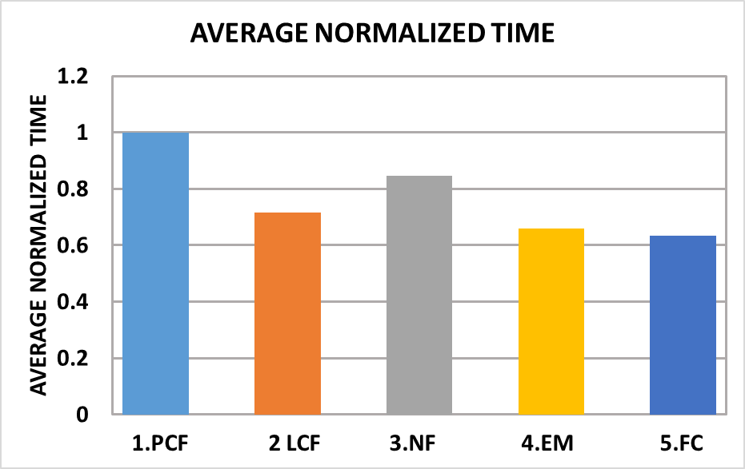
Simulation results using real time task graphs
Notes:
We applied the mapping algorithms to task graphs of the application in Figure.
Like a) DVOPD, b) VOPD, c) MPEG -4, d) PIP, e) MWD, f) 263enc mp3dec
To obtain timing accuracy, each mapping is run for more than 200 times and then the resulting execution times are averaged.
On average, the communication cost with other mapping algorithms is 72% more than with PCF.
On average, the execution time for other algorithms is 30% faster than with PCF.
PCF yields energy savings as the run time for these applications is much longer than the mapping execution time,
Till now we are just talking about mapping.

Slide 24
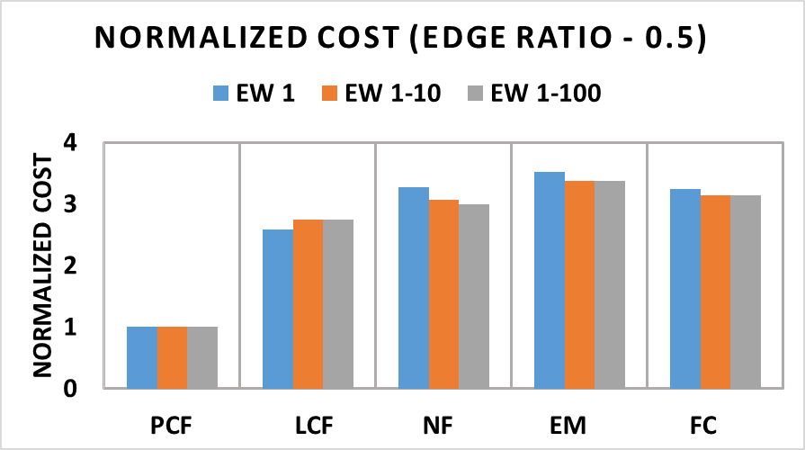
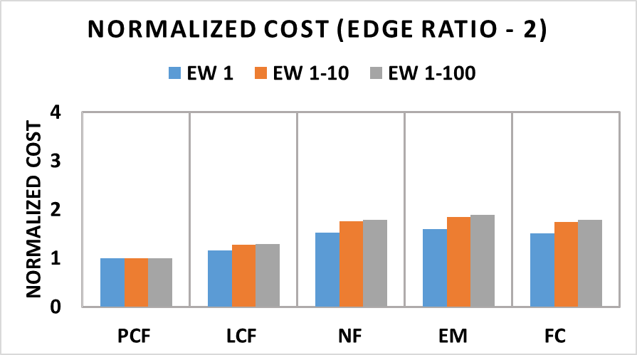
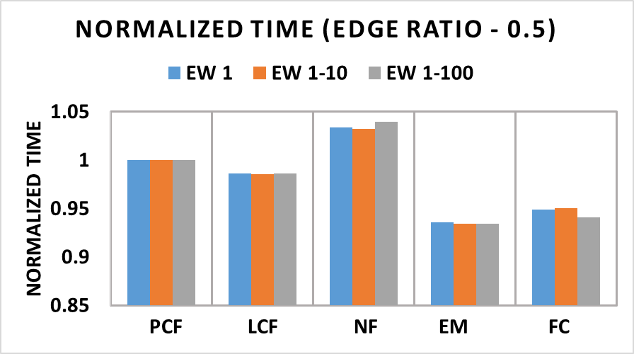
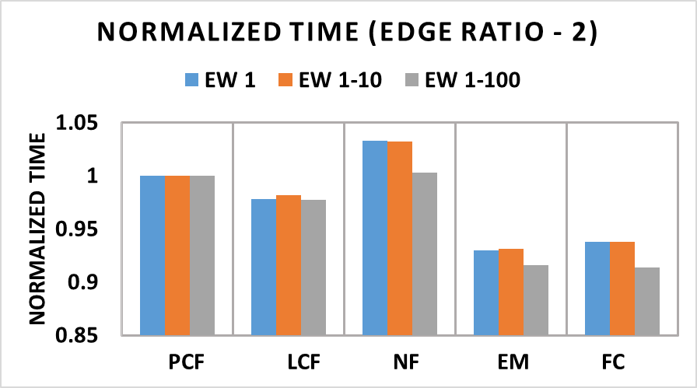
Simulation results using scheduler [2]
Notes:
With scheduling we have 300 application that the scheduler finds the place for them to put in whatever space is available here we are looking at more active setting.
As we vary no of tasks per application randomly.
The following experiments are run to test the mapping algorithms, behavior when attached with region selection.
Here we consider varying application size to simulate a real world online scenario. The scheduler tries to schedule applications as they arrive.
Some parameters
NoC size = 32 × 32. Number of applications = 300. Number of runs per experiment =210.
Number of tasks per application = [10 - 100] (randomly selected).
The experiment is run on random generated task graph with edge ratios of 0.5, 2, and 20.
also max edge weight (EW) of 100.
These results indicate that a scheduler running the PCF mapping algorithm yields better energy savings than with other mapping algorithms. The normalized time shows that the execution time for other algorithms is up to 12% faster than with PCF.
We did explore this situation because to show that PCF performs better even in this setting.

Slide 25
Conclusion and Future Work
The results show that PCF outperforms other mapping algorithm in most situations in terms of energy savings.
On average, the communication cost with other mapping algorithms is 72% more than with PCF, and execution time for other algorithms is 30% faster than with PCF for real application task graphs.
In the future we plan to apply this techniques to heterogeneous many-cores.
We also plan to consider the platforms allowing dynamic voltage and frequency scaling, as incorporating this technique can provide further energy savings.
Notes:
summarizing.
an

Slide 26
References
[1] C.-L. Chou, U. Y. Ogras, and R. Marculescu (2008), “Energy- and Performance-Aware Incremental Mapping for Networks on Chip With Multiple Voltage Levels,” IEEE Trans. Computer-Aided Design of Integrated Circuits and Systems, vol. 27, no. 10, pp. 1866-1879.
[2] M. Elbidweihy and J. L. Trahan, (2009) “Maximal Strips Data Structure to Represent Free Space on Partially Reconfigurable FPGAs,” International Journal of Parallel, Emergent and Distributed Systems, vol. 24, no. 4, pp. 349-366.
[3] C. A. M. Marcon, E. I. Moreno, N. L. V. Calazans, and F. G. Moraes (2008), “Comparison of Network-on-Chip Mapping Algorithms Targeting Low Energy Consumption,” IET Computers & Digital Techniques, vol. 2, no. 6, pp. 471-482.
[4] J. L. Trahan and M. Elbidweihy (2013), “Task Mapping Heuristics Descriptions,” manuscript.

Slide 27
Questions.....

Slide 28
Thank You

